Slide 1

Conducted By :
Mohamed Zakarya
Banking Analysis
banking and financial services, specifically focusing on loan management and customer financial transactions. It covers various aspects of lending, including different types of loans (e.g., Personal, Auto, Education), loan amounts, interest rates, and customer behavior.

Slide 2

Exploration The Dataset
The Customers table provides demographic data such as customer ID, name, city.
The Accounts table tracks account types, balances, and account IDs linked to customers.
The Transactions table records financial activities such as deposits, withdrawals, and transfers over time.
The Loans table includes information on loan amounts, interest rates, and loan types (e.g., personal, auto, education).

Slide 3
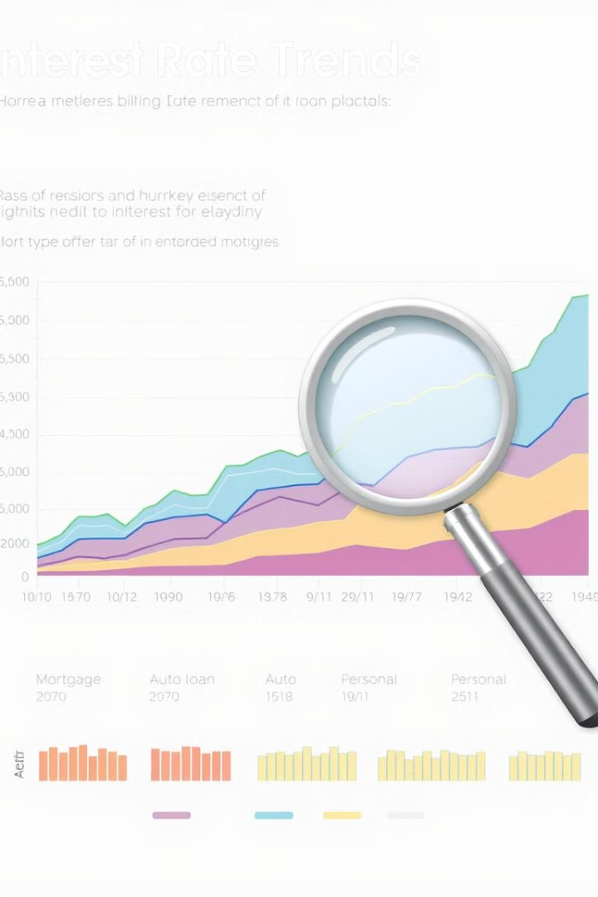
Transactions Assumptions
The Deposit interest = deposit amount * .01
Transaction fees for every single transaction is 3EGP

Slide 4

Loans Assumptions
The loan Age years : calculate the age of the loan
Loan age group : describe every loan fall in different category
Categories : 1. New loan >>>> l oan ages less than one year
Maturing loan >>>> loan age between 1 and 3 years
Old loan >>>> loan age more than 3 years
high Risk loans : Personal loans are considered highly Risk more than other
Revenues : the total loan amount * interest rate

Slide 5

Objectives
1. Liquidity Analysis: Assess the balance between loans and deposits
2. Profitability: Analyze interest income from loans and loan growth
3.Credit Risk Management: Monitor loan default rates, non-performing loans (NPL),
4. RFM Analysis: Understand customer behavior and Engagement

Slide 6

Key Metrics and Ratios in Banking
Liquidity &Profitability KPIS
Metric
Description
Average revenue generated per customer minus associated costs.
Customer Lifetime Value (CLV)
Net Interest Margin (NIM)
Difference between interest earned on loans and interest paid on deposits
Cost-To-Deposit Ratio(CIR)
managing its costs relative to its income.
Churn Rate
percentage of customers who stop to use the bank’s services

Slide 7

Credit Risk KPIS
Metric
Description
1. Non-Performing Loan (NPL) Ratio
percentage of loans that are not being repaid on time
2.Loan Default Rate
percentage of loans that have defaulted compared to the total loan portfolio.
3.Loan-to-Deposit Ratio (LDR)
Proportion of loans to deposits

Slide 8

RFM Analysis KPIS
Metric
Description
1. Recency
Last Transaction per customer
2. Frequency
How many transactions per customer
3.Monetary
Total amount that customer payed
4.Last Transaction date
maximum transaction date

Slide 9

Power-BI Report

Slide 10


Slide 11


Slide 12

What is RFM in Marketing?
Recency: How much time has elapsed since a customer’s last activity or transaction with the brand? Activity is usually a purchase, although variations are sometimes used, e.g., the last visit to a website or use of a mobile app. In most cases, the more recently a customer has interacted or transacted with a brand, the more likely that customer will be responsive to communications from the brand.
Frequency: How often has a customer transacted or interacted with the brand during a particular period of time? Clearly, customers with frequent activities are more engaged, and probably more loyal, than customers who rarely do so. And one-time-only customers are in a class of their own.
Monetary: Also referred to as “monetary value,” this factor reflects how much a customer has spent with the brand during a particular period of time. Big spenders should usually be treated differently than customers who spend little. Looking at monetary divided by frequency indicates the average purchase amount – an important secondary factor to consider when segmenting customers.

Slide 13

HOW To Perform RFM
Step 1: Assign Recency, Frequency & Monetary Values
Step 2 :Divide Customers into Tiers
Step 3 : Create Customer Groups
Customer Groups
Score between 124 to 255 >>>>> At Risk
Score Between 213 to 331 >>>>About to sleep
Score between 113 to 215 >>>>> can no lose them
Score between 335 to 444 >>>>> Loyal
Score between 324 to 498 >>>>> Need attention
Score between 311to 512 >>>>> New Customer
Score between 499to 511 >>>>> Promising
Score between 512 to 555 >>>>> Champion
Score between less than 100 >>>>> Lost Customer

Slide 14


Slide 15

Conclusion
Profitability
1
the bank is performing well in terms of revenue generation and cost control, with profitability driven by a healthy loan portfolio.
2
Liquidity
withdrawals are high and the loan-to-deposit ratio suggests an over-reliance on lending relative to deposits. This poses a potential liquidity risk, impacting the bank's ability to meet its short-term financial obligations
3
Credit Risk
61% of loans Fall in default loan ,The (NPL) about 26% and the Loan Growth Rate increase every single year by 16% which is mean , more generates revenues from interests on loan
4
Customer Segmentation (RFM)
Increased in new customers but in the same time there is higher number of losing customers and the average monetary for every customer is good

Slide 16



Recommendations
Liquidity
Customer
Sustainable Growth
1.Improve liquidity by balancing loan growth with deposit acquisition.
2.Enhance customer retention strategies to minimize churn and increase long-term customer value.
3.Strengthen credit risk management to reduce default rates.

